Slide 1
Performance Tuning ASP.NET Applications
Software Test & Performance Conference
April 17 - 19, 2007
Part I

Slide 2
Introduction
Thomas O’Mara, President
  TEOInnovations, Inc.
  Microsoft Certified Professional
    C# Windows Application Development
    C# Web Based Application Development
    Visual Basic 6.0 Distributed Application Development
  thomaso@teoinnovations.com
  www.teoinnovations.com

Slide 3
Relevant Experience
Countrywide Home Loans
  IBM AS/400 Evaluation – PETE scripts
  AS/400 Advanced Server (4, 8, 12 CPU)
  900 Users - 5250 emulators
Kinko’s Corporate
  AMS (Web Application) Scalability testing
  Segue Silk Performer
  2 Compaq Proliant dual Xeon CPU’s
  HP9000/HP-UX 4 CPU DB Server (Informix)
  1500 Users
Amgen
  Licensing Application Evaluation
  Load Runner 8.1
  Windows Server 2003/IIS 6.0
  UNIX/Oracle 9.x
  50 Users

Slide 4
Relevant Experience
Fiserv/XP Systems
  Credit Union Application (ASP.NET)
  Load Testing Environment
    Mercury Astra Load Test v5.4.3
    Load Runner v7.5
  Performance Benchmark and Scalability Initiative
  5 Dell 2650 dual CPU Xeon servers
  IBM RS6000/AIX 5.x, 8 CPU, 52 HDD’s DB Server (DB2 UDB)
  Running 300 virtual users at 10 TPS with an average response time < 2 seconds.

Slide 5
Attendee Demographics
Managers – Insight into the ASP.NET technology.
Architects – Insight into application architectural design from a performance standpoint.
Developers - Insight into an object - oriented implementation from a performance standpoint.

Slide 6
Talk Overview
Objectives
  Provide by example and notes: ASP.NET application performance tuning from an overall system standpoint utilizing “Best Practice” development techniques.

Slide 7
Technologies
Windows Server 2003/IIS 6.0
.NET Framework 1.1/2.0
ASP.NET 1.1/2.0

Slide 8
Performance Metrics
Execution Time
  The time it takes to process a request, typically measured between the first byte and the last byte returned to the client from the server. Execution time directly affects the throughput calculation.
Response Time
  The length of time between when a request is requested and when the first byte is returned to the client from the server. This is often the most perceptible aspect of performance to the client user.

Slide 9
Performance Metrics
Scalability
  The measurement of an application's ability to perform better as more resources (memory, processors, or computers) are allocated to it. Often, it is a measurement of the rate of change of throughput with respect to the number of processors (Vertical and Horizontal).
Throughput
  The number of requests a Web application can serve per unit of time, often measured in requests per second. Throughput can vary, depending on the load (number of client threads) applied to the server. This is usually considered the most important performance metric to optimize.

Slide 10
.NET Framework
CLR – Common Language Runtime
  Run-time services
    Language integration – C#, VB.NET, C++.NET, Eiffel, Cobol…
    Security enforcement – Role based and Code Access security.
    Memory, process, and thread management
CTS – Common Type System
  Defines how types are declared, used, and managed in the runtime.
  Integral to the runtime's support for cross-language integration.
CLI – Common Language Infrastructure
  Common Type System – See above.
  Metadata – Type declaration management - resides in the Assembly.
  Common Language Specification - A set of rules intended to promote language interoperability.
  Virtual Execution System - The VES is to provide the support required to execute the Common Intermediate Language instruction set.

Slide 11
.NET Framework - CLR
CLR
  Cross-language integration, especially cross-language inheritance.
  Garbage collection, which manages object lifetime so that reference counting is unnecessary.
  Self-describing objects, which make using Interface Definition Language (IDL) unnecessary.
  The ability to compile once and run on any CPU and operating system that supports the runtime (Wintel, Linux-Mono).
CLR Performance improvements.
  The ability to easily use components developed in other languages.
  Extensible types provided by a class library (Inheritable).
  New language features such as inheritance, interfaces, and overloading for object-oriented programming; support for explicit free threading that allows creation of multithreaded, scalable applications; support for structured exception handling and custom attributes.

Slide 12
.NET Framework - Garbage Collection
Garbage Collector (GC)
  Self-Tuning memory sub-system to specific processor type as a function of processor cache size, dynamic workload, object locality, and multiprocessor configuration.
  Utilizes the Microsoft Win32® API VirtualAlloc() method to reserve a large contiguous region of virtual memory called the managed heap.
  Commits memory as managed heap grows.
    Dynamic allocation – “new” operator.
  Places the next allocation request at a specified location by keeping track of the next available address at the end of the managed heap.
  Garbage Collection
    Heuristically determined as a function of allocation pressure and generation size.
  Heap compaction
    Walks root reference tree for active instantiated object references.
  Pinned objects
    Objects the GC has been instructed not to move during a collection, typically object address has been passed to a native API.

Slide 13
.NET Framework – Garbage Collection
Collector Types
  Server (MSCorSvr.dll)
    Splits managed heap into sections – one managed heap per CPU.
    Individual garbage collection thread per CPU.
    Synchronized Garbage Collection – All CPU collection thread participate simultaneously in the collection cycle.
  Client (MSCorWks.dll)
    Due to performance reasons - default on Single CPU machines
    Application runs concurrent during full collections

Slide 14
.NET Framework – Garbage Collection
Managed Heap
  Contiguous block of memory – Stack like architecture (Push, Pop, Peek, Poke).
    Reference pointer to next available address.
    Increase locality – optimized to CPU cache.
    Increased processor cache hit ratio.
  Generational Mark and Sweep
    Card Table – A data structure to remember the location of dirty objects.
    Write Barriers – Maintains the Card Table data structure.
  Large Object Heap > 85 KB
    Never compacted - object heap does not de-commit the virtual memory allocated.
    Virtual Memory blocks – independent of the Managed Heap.

Slide 15
.NET Framework – Garbage Collection
Resource Allocation Profile
  A function of the number of objects allocated, the size of those objects, and their lifetimes.
  Allocation Friendly
    Application initialization – a few objects surviving until completion.
    The majority of objects are short lived and recycled.
    Long lived object have no references to short lived objects.
  Allocation Un-Friendly
    Allocated objects surviving to Gen2 then perishing.
    Many short-lived objects being allocated in the Large Object Heap.
    Objects in older generations containing references to objects in younger generations during a collection cycle.
  Tools
    Allocation Profiler (Microsoft)
    Compuware DevPartner

Slide 16
.NET Framework – Garbage Collection
Generations
  Gen 0 – 256KB
    Collection time = 10 msec.
    Processor L2 Cache size resolution.
    Statistical probability object will be in L2 Cache.
  Gen 1 – 2MB
    Gen 1 and Gen 0 collection
  Gen 2 – 10MB
    Full collection (Gen 0, 1, & 2)
  Allocations are adjustable based on allocation patterns
  Older objects migrate to higher generations - Survivors

Slide 17
.NET Framework – Garbage Collection
Roots - Roots identify storage locations, which refer to objects on the managed heap or to objects that are set to null.
  .NET Applications contain a set of Roots that includes:
    Global and Static Objects.
    Associated thread stacks.
    Dynamically instantiated objects.
  Rooted - If the object has at least one parent object that holds a reference to it.
    Live references indicate a “Strongly Rooted object.
References
  Reference Tree – A logical interpretation of a tree like structure that tracks object references in the application
  Weak – Allows the object to be referenced after collection.
    Short weak reference – Does not track resurrection.
    Long weak reference – Tracks resurrection (Unpredictable).
      Resurrection – An object is revived after finalization.
  Strong – A root that has a reference pointer to an object.

Slide 18
.NET Framework – Garbage Collection
Object Cleanup
  Typically the object is marked for collection when the object goes out of scope or is set to null. However, there are special cases:
    File I/O, network sockets, or database connections.
  Finalization
    Objects with Finalize() methods reside in the finalization queue.
    Non-deterministic process model ramifications on application clean up process.
    Finalizable objects are promoted to higher generations that create memory pressure and force multiple collections.
    Finalize() method
      Called by Garbage Collector in an unpredictable order.
      Keeps child object references and only frees memory after next garbage collection.
  Dispose
    Dispose() method
      Used to close or release unmanaged resources such as files, streams, and handles held by an instance of the class that implements this interface.
      Explicitly ordered and called by application.
      Returns resources upon call completion.

Slide 19
.NET Framework – Garbage Collection
TIP: Keep your objects as small as possible. Return and store only the data used to provide the needed functionality. Large data structures can tie up critical resources. Also, reduce the amount of indirection by limiting the number of layers of abstraction in the application architecture. Sequence diagrams and clever object design will help immensely in those areas.
TIP: The web application will reside on a server, so utilize the Server GC for scalability.
TIP: In the case of a parent object holding a reference to a child object but does not want to affect the parent object lifetime, use a weak references. For example, a large data structure is used to store customer data that is needed for application initialization and subsequent calls. If a weak reference is created, the object will survive collections only if there is sufficient memory.

Slide 20
.NET Framework – JIT Compilation
Definition – Just in Time (JIT) compiler resides in the CLR performing compilation services for program execution.
Types
  Standard - Converts MSIL (Microsoft Intermediate Language) to the respective native instruction set.
  Install-time code generation - The same as the standard JIT compiler, but converts larger units of code at a time, thus storing the resulting native code for use when the assembly is subsequently loaded and run.
  EconoJIT - Compiles faster than the standard JIT compiler, but the code it produces is not as optimized as the code obtained from the standard JIT compiler.

Slide 21
.NET Framework – JIT Compilation
Just-In-Time Compiler (JIT)
  Process
    Converts high level language code (C#, VB.NET) to MSIL and produces metadata.
      MSIL - CPU-independent set of instructions that can be efficiently converted to native code.
      Metadata - Metadata describes the types in your code, including the definition of each type, the signatures of each type's members other data the runtime uses at execution time.
    Merges the MSIL and metadata into Portable Executable (PE) CPU specific native code on a as needed basis.
      Portable Executable (PE) file - Based on the published Microsoft PE and common object file format (COFF) used for executable content and accommodates MSIL and metadata, enabling the operating system to recognize common language runtime images.
    Compiles the MSIL to respective native instruction set and stores them on the JIT Code Heap..

Slide 22
.NET Framework – JIT Compilation
Compiler Optimizations
  Code Semantics
    Constant Folding - Calculate constant values at compile time.
    Constant and Copy-Propagation - Substitute backwards to free variables earlier.
    Method In-lining - Replace arguments with values passed at call time, and eliminate the call.
    Code Hoisting and Dominators—Remove code from inside loops if it is duplicated outside.
  Processor Specific
    Code set compiled to specific processor family.
      Leverages the Intel NetBurst™ architecture innovations and hyper-threading technology.
        20-stage execution pipeline, new cache architecture, streaming 128-bit arithmetic (called SSE-2): operations, and accelerated system bus.
      Streaming SIMD Extensions 2 (SSE2).
        Single Instruction, Multiple Data – 128 bit (4 32 bit words).

Slide 23
.NET Framework – JIT Compilation
TIP: To alleviate long response times in application start up, use the .NET Framework tool NGEN.exe. This is typically used for client applications, but may show performance improvement on server based applications.
TIP: Since the JIT compiler inlines methods that are < 32 bytes of IL, methods should be as short as possible. If there are large complex methods in the application, consider breaking the methods up into small compact units. This will certainly aid in JIT duration, debugging, and readability.

Slide 24
.NET Framework – Memory Issues
Memory leaks vs. Memory consumption
  Memory Leak – A memory leak occurs when you allocate memory on the heap and never de-allocate that memory to make it available for reuse, or if you mistakenly use memory that has already been allocated.
    Indicator:
      Private Bytes and Virtual Bytes increase on a positive slope without recession.
  Memory Consumption - Memory-related problems that aren't "true" memory leaks, but exhibit memory-leak symptoms.
    Indicator:
      Native - Private Bytes increases while the .NET # of Bytes in all Heaps stays flat.
      Managed - Private Bytes and .NET # of Bytes in all Heaps increase at the same rate.

Slide 25
Web Based Application Infrastructure
Microsoft Windows Server 2003
  Data Center, Enterprise, Standard, and Web Editions.
  Internet Information Server 6.0
    Architecture
      Process Model
      HTTP Protocol Stack (HTTP.sys)
        HTTP.sys, is the kernel mode listener that handles all HTTP traffic by routing HTTP requests to the correct request queue.
        Performs caching of responses in kernel mode.
        Performs all text-based logging for the WWW service.
        Implements Quality of Service (QoS) functionality, which includes connection limits, connection timeouts, queue-length limits, and bandwidth throttling.

Slide 26
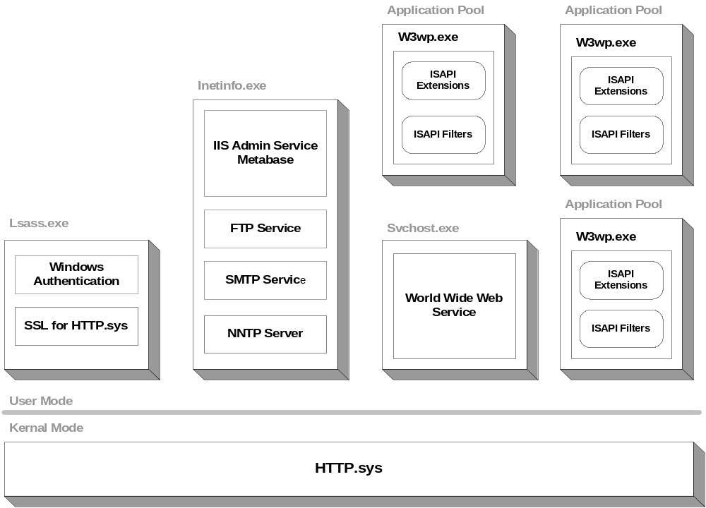
Web Based Application Infrastructure

Slide 27
Web Based Application Infrastructure
Internet Information Server 6.0
  Running ASP.NET in IIS worker process isolation mode:
  Utilizes the IIS 6.0 request processing model settings.
  Enables application pools.
  Worker process recycling.
  Worker process Health detection.
  Support for affinities between worker processes and particular CPUs on a server with multiple CPUs.
  ASP.NET does not run under the surrogate process inetinfo.exe.

Slide 28
Web Based Application Infrastructure
Internet Information Server 6.0
  Performance Enhancements
    Kernel-mode caching. Requests for cached responses are served without switching to user mode.
    Kernel-mode request queuing. Requests cause less overhead in context switching, because the kernel forwards requests directly to the correct worker process. If no worker process is available to accept a request, the kernel-mode request queue holds the request until a worker process picks it up.
  Performance Benefits
    When a worker process fails, service is not interrupted because the kernel queues the requests while a new worker process for that application pool.
    Requests are processed faster because they are routed directly from the kernel to the appropriate user-mode worker process instead of being routed between two user-mode processes.

Slide 29
Web Based Application Infrastructure
Internet Information Server 6.0
  Metabase – The IIS metabase is a plaintext, XML data store that contains most IIS configuration information.
    MetaBase.xml file - This file stores IIS configuration information that is specific to an installation of IIS.
    MBSchema.xml file - This file contains the metabase schema.
    In-memory metabase - The in-memory metabase contains the most current metabase and metabase schema configuration.

Slide 30
Web Based Application Infrastructure
Internet Information Server 6.0
  Application Pool – Defines a set of Web applications that share one or more worker processes.
  Each pool runs in a single w3wp.exe process.
  Note: An application in one pool is not affected by other application pools.
  Settings
    Idle Timeout
    Request Queue Limit
    CPU Monitoring
    Web Garden
    Enable Pinging
    Enable Rapid Fail Protection
    Startup Time Limit
    Shutdown Time Limit

Slide 31
Web Based Application Infrastructure
Network
  Bandwidth latency
    Transfer rates (Throughput)
      DSL - 384Kbs
      T1 – 1.544Mps
      T3 – 45Mps
  Performance/Payload trade-offs
    IIS Compression (Configured in Metabase.)
      CPU
    Page content
      Images and Text
      ViewState
    Process workflow fragmentation
      Break large pages into smaller grouping.

Slide 32
ASP.NET Architecture
ASP.NET Web Application Fundamentals
  ASP.NET - A flexible and extensible framework for server-side HTTP programming based on the MVC design pattern.
    Not backward compatible with classic Active Server Pages.
    Recognized by the *.aspx extension.
  ASP.NET Applications are Stateless - Each request for a new Web page is processed without any knowledge of previous pages requested. Stateless issue handled by Hidden fields, Session State, and ViewState.
  Based on a Request/Response workflow – Messages flowing to and from the ASP.NET framework .
  Application Domain – An AppDomain is a lightweight process within a process Application.
    One AppDomain per Asp.NET application.

Slide 33
ASP.NET Architecture
Performance Considerations:
  On the initial request, the page is dynamically compiled. The CLR JIT compiles ASP.NET managed page code to the native code of the processing server at run time.
  When the Page instance has been compiled for the initial request, it is cached server side. Thus each subsequent request for the respective page, the cached instance of the class is executed. After the initial request, the Page class is recompiled only when the original source for the page or one of its dependencies has changed.
  ASP.NET caches internal objects, such as server variables, to speed user code access.

Slide 34
ASP.NET Architecture
HTTP Pipeline - The pipeline is the general-purpose framework for server-side HTTP programming that serves as the foundation for ASP.NET pages as well as Web Services.
  HTTP Runtime
    HTTP Handlers
    HTTP Modules

Slide 35
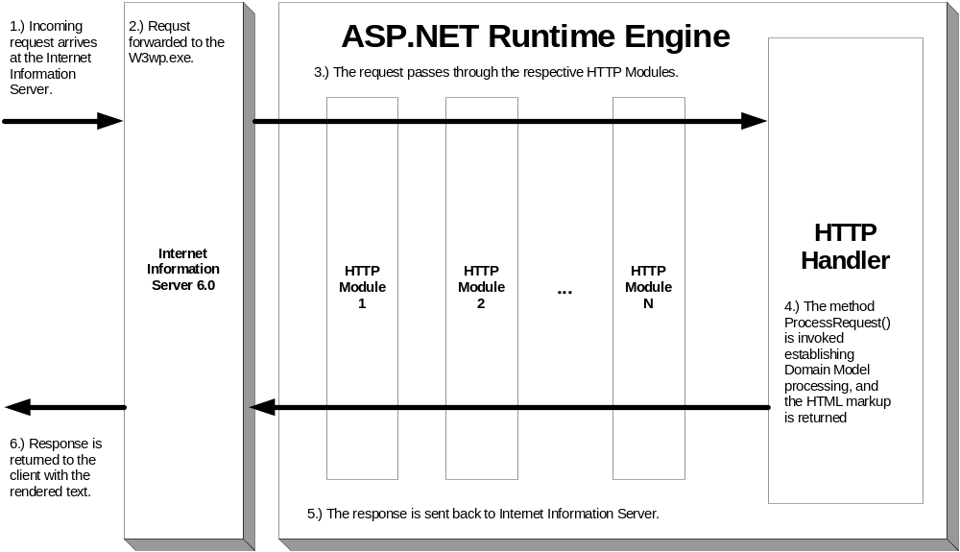
ASP.NET Architecture

Slide 36
ASP.NET Architecture
HTTP Pipeline Architecture
  HTTP Runtime
    Entry point in to the HTTP Pipeline
    Employs HttpApplicationFactory to either find or create an HttpApplication object to process the request.
    HttpApplication holds a collection of HTTP module objects, implementations of the IHttpModule interface.
    HTTP handlers and handler factories implement the IHttpHandler and IHttpHandlerFactory interfaces, respectively.
    ProcessRequest() method (default System.Web.UI.Page class implementing IHttpHandler)
    HttpContext object exposes properties representing the HTTP request and response messages, which are instances of the HttpRequest and HttpResponse classes,
    Initializes helper objects
      Cache object, HttpWriter object,
      Application Object – Global.asax
        Pooled

Slide 37
ASP.NET Architecture
HTTP Pipeline Architecture
  HTTP Handlers
    Standard HTTP handlers are classes that implement the IHttpHandler interface and by default ASP.NET creates a handler based on System.Web.UI.Page when processing an *.aspx web page.
      Implements IhttpHandler
        ProcessRequest() method
      Predefined handlers for common resource types (aspx, ashx)
    Custom HTTP Handlers – These handlers implement IHttpHandlerFactory interface to employ the FrontEnd Controller design pattern.
      Wired into the application via web.config file.
    Declared in the machine.config or web.config files.

Slide 38
ASP.NET Architecture
HTTP Pipeline Architecture
  HTTP Modules - HTTP modules are filter objects that process HTTP request and response messages as they traverse the HTTP pipeline.
    Declared in the machine.config or web.config files
    Intercepts requests through event trapping for application security and session management.
      BeginRequest, EndRequest
      AuthenticateRequest, AuthorizeRequest

Slide 39
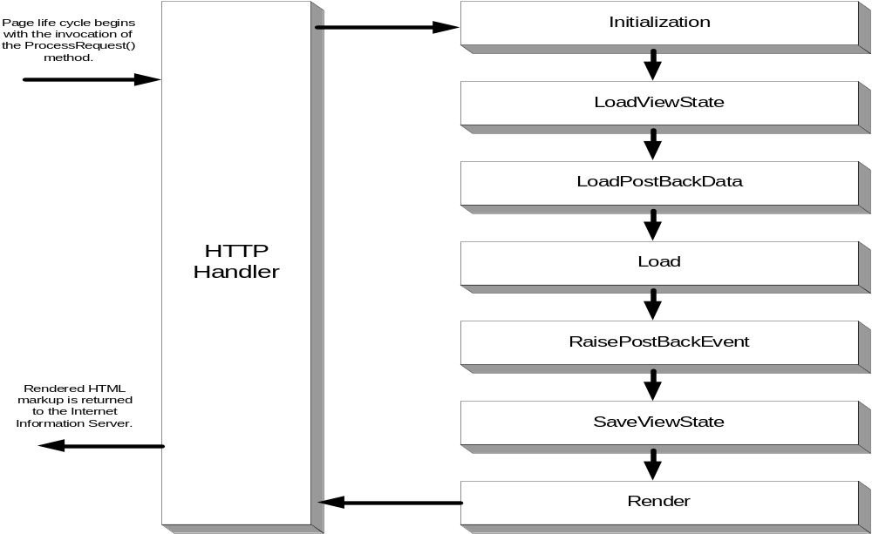
ASP.NET Architecture
Note: Framework 2.0 increases the Page Life Cycle resolution with 30 events.

Slide 40
ASP.NET Components 1.1/2.0
Session State
View State
Cache
Posting Back
Server Side Controls

Slide 41
ASP.NET Components 1.1/2.0
Session State
  Server-side abstract layer independent of HTTP infrastructure
  HttpSessionState – In-Memory Session State Dictionary
  SessionStateModule implements IhttpModule.
    De-serializes the session values into the HttpSessionState dictionary object at the beginning of the request.
    Serializes the session values into the HttpSessionState dictionary object at the end of the request.
  State providers
    In-Proc - Session values are kept as live objects in the memory of the ASP.NET worker process (aspnet_wp.exe or w3wp.exe in Microsoft® Windows Server™ 2003). This is the default option. Stored in a private slot (not programmatically accessible) of the ASP.NET Cache object.
    State Server - Session values are serialized and stored in the memory of a separate process (aspnet_state.exe). The process can also run on another machine. A Windows NT service named aspnet_state.exe
    SQL Server - Session values are serialized and stored in a Microsoft® SQL Server™ table. The instance of SQL Server can run either locally or remotely.

Slide 42
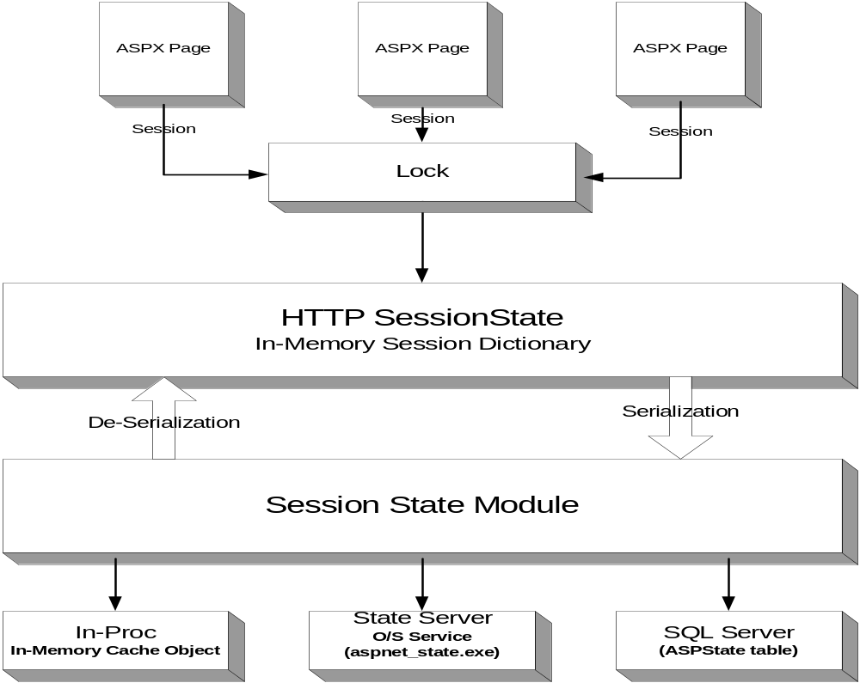
ASP.NET Components 1.1/2.0

Slide 43
ASP.NET Components 1.1/2.0
TIP: If the application is content based only and requires no data, disable Session State.
TIP: If data security is not an issue, consider using an html based input tag with type = hidden (Hidden Field) and extracting the data in the form request collection.
TIP: In the architectural phase of the application, perform a detailed analysis on how the Session State provider will be employed from a scalability standpoint. This will have a significant impact on performance.

Slide 44
ASP.NET Components 1.1/2.0
View State - Automatic page level state management for maintaining page information across the Request/Response workflow.
  Storing the View State Data
    Stored in Key-Value pairs in the System.Statebag object.
      ASP.NET 2.0 uses a number of nonprintable characters to mark the beginning of an object and to describe what type of object it is. 50% reduction in the size of the encrypted text that is holding the page state.
      ASP.NET 1.1 a collection of printable characters to delineate objects.
    For security, the data is encrypted and stored in a hidden field __VIEWSTATE on the page.
      Note: The View State is transported to and from the server as part of the contents in the web page.
    View State validated in the LoadViewState event.

Slide 45
ASP.NET Components 1.1/2.0
Optimized for the following types:
    Integer, boolean, string, and other primitive types {both boxed and unboxed versions}
    Arrays of primitive types, ArrayList, and Hashtable
    Any type that is marked with the serializable attribute, or supports the serializable interface

Slide 46
ASP.NET Components 1.1/2.0
View State
  Controlled at 4 levels
    Machine level: machine.config
    Application level: web.config
    Page level: @Page directive
    Control level: ViewState property
  View state in enabled at all levels by default.
  Each level inherits the setting in the preceding level by default.
  Only controls using the <form runat=server> tag in the .aspx page can store view state.
  Note: CheckBox, TextBox, DropDownList, ListBox, RadioButton implement the IPostBackDataHandler interface.

Slide 47
ASP.NET Components 1.1/2.0
View State
  Request/Response workflow
    LoadViewStateEvent
      Page.LoadPageStateFromPersistenceMedium()
        Loads any saved view-state information to the Page object.
      De-Serialized
      Decoded
    SaveViewStateEvent
      Page.SavePageStateFromPersistenceMedium()
        Saves any view-state information for the page
      Encoded
      Serialized

Slide 48
ASP.NET Components 1.1/2.0
TIP: Use ViewState only as needed. If needed, persist only the key elements required for functionality. ViewState by default is set to true, so set ViewState = false on all other controls. This will reduce the amount of resources and time needed to managed the ViewState functionality.

Slide 49
ASP.NET Components 1.1/2.0
Caching – An in-memory dictionary that allows you to store arbitrary data. It is implemented by the Cache class, with instances private to each application, and its lifetime is tied to that of the application.
  Stores data as the object type
    Variables, Hash tables, Datasets, etc…
  Provides expiration functionality for those objects.
    Absolute and Sliding.
  Methods that allow you to add and removed the objects.
    Add, Get, Insert, and Remove.
  Add the objects with a dependency upon other files or cache entries.
  Perform a callback to notify your application when an object is removed from the Cache.

Slide 50
ASP.NET Components 1.1/2.0
Caching
  Cache Management
    Flushing Data from Cache
      Explicit Flushing - Explicit flushing requires that you write the code to determine when the item should be flushed and the code to flush it.
      Scavenging - A scavenging algorithm is utilized to automatically remove seldom used or unimportant items as a function of priority from the cache when system memory or some other resource becomes scarce.

Slide 51
ASP.NET Components 1.1/2.0
  Caching Types
    Page level - Cache the entire response content for dynamic pages on HTTP 1.1 capable mechanisms.
      High-level declarative API
        The @ OutputCache directive in the .aspx file for the page.
      Low-level programmatic API
        Manipulate output-cache expirations and policies for a page via the HttpCachePolicy class.
    Fragmentation – Identify the objects or data associated with the page request, isolating them in Web Forms user controls, and store them in cache.
      @ OutputCache directive in the user control.
      PartialCachingAttribute or StaticPartialCachingAttribute class.

Slide 52
ASP.NET Components 2.0
Automatic Cache Management (SQL Server Only)
  SqlCacheDependency Class - Create a cache item dependency on a table or row in a database. When a change occurs in the table or in a specific row, the item that has a dependency that is invalidated and removed from the cache.
  Note: SQL Server 7.x and 2000 dependencies are table level. SQL Server 2005 dependencies are at the row level.
  SQL cache dependency can also be used for both application and page level output caching.

Slide 53
ASP.NET Components 1.1/2.0
TIP: Cache only data that is static for extended periods.
TIP: Do not cache too many objects. This will lead to large memory allocations and put undue pressure that forces scavenging when not needed.
TIP: Analyze the lifetime duration of the object residing in cache. This can have a significant impact on the cache turnover rate, which in turn, utilizes needed system resources.

Slide 54
ASP.NET Components 1.1/2.0
Posting back
  Postback - By implementing the System.Web.UI.IPostBackDataHandler interface a control can examine form data that is posted back by the client. This allows the control to determine whether its state should be altered as a result of the postback and to raise appropriate events.
    LoadPostData() - Upon post back, returns true if the server control's state changes - otherwise false.
    RaisePostDataChangeEvent() - Alerts the server control object to notify the ASP.NET application that the state of the control has changed.
  Raise Event - Implementing the System.Web.UI.IPostBackEventHandler interface allows a control to raise events on the server in response to postback from the client.
    RaisePostBackEvent() - Enables a server control to process an event raised when a Web form is posted back to the server.
  AutoPostBack - When set to true, automatically posts back to the server when the respective control is clicked.

Slide 55
ASP.NET Components 1.1/2.0
TIP: Implement a page design strategy to interrogate all the controls at a form level post back. This will alleviate unwanted request/response round trips.
TIP: Use server side controls prudently. Keep in mind that the server needs to wire up and process all the events, methods, properties, and then dynamically generate the HTML on the return.
TIP: If multiple post backs are needed, use Asynchronous JavaScript and XML (AJAX) or the new Atlas technology from Microsoft. These post backs are lightweight and reduce system resources because only fragments of the page are posted back to the server.

Slide 56
Questions and Answers
Contact information
  thomaso@teoinnovations.com
  www.teoinnovations.com
Questions - ??????

Slide 57
References and Links
Mercury – Load Runner 8.0
  http://www.mercury.com
Software Testing and Performance Engineering
  http://www.perfeng.com
Internet Information Server 6.0
  IIS 6.0 Documentation (TechNet)
.NET Framework 1.1
  http://msdn.microsoft.com/netframework
ASP.NET
  http://msdn.microsoft.com/asp.net/

Slide 58
Related Related White Papers, Articles, and Documentation
Mercury Load Runner
  Tips and Tricks for Configuration, Scripting, and Execution.
  Load Testing to Predict Web Performance.
.NET Framework
  Garbage Collector Basics and Performance Hints.
  Garbage Collection: Automatic Memory Management in the Microsoft .NET Framework
  Garbage Collection—Part 2: Automatic Memory Management in the Microsoft .NET Framework
ASP.NET
  Underpinnings of the Session State Implementation in ASP.NET.
  Cutting Edge The ASP.NET View State.
  HTTP Pipelines Securely Implement Request Processing, Filtering, and Content Redirection with HTTP Pipelines in ASP.NET.

Slide 59
Related Related White Papers, Articles, and Documentation
Performance Tuning - .NET Framework
  ASP.NET Performance Overview
  Performance Tips and Tricks in .NET Applications
  .NET Framework General Reference: Memory Performance Counters
  Performance Considerations for Run-Time Technologies in the .NET Framework
  Boosting the Performance of the Microsoft .NET Framework
  Garbage Collector Basics and Performance Hints
  Writing High-Performance Managed Applications : A Primer
  Production Debugging for .NET Framework Application
Performance Tuning – ASP.NET
  .NET Framework Developer's Guide: Performance Counters for ASP.NET

